Slide 1
The Ethics Appraisal Scheme in Horizon Europe
Sharing the responsibility
Isidoros KARATZAS, Head of the Research Ethics & Integrity Sector
SCIENCE POLICY, ADVICE & ETHICS Unit
European Commission, DG Research & Innovation

Slide 2
What is Ethics?

Slide 3
TRUST
Trust takes years to build, seconds to break, and forever to fix.

Slide 4
Regulation establishing Horizon Europe Article 19
‘Actions carried out under the Programme shall comply with ethical principles and relevant Union, national and international legislation, including the Charter of Fundamental Rights of the European Union and the European Convention on Human Rights and its Supplementary Protocols.’

Slide 5
The Ethics Appraisal process in the HE Regulation
Regulation ** Article 19 (2)
‘Entities participating in the action shall provide:
(a) an ethics self-assessment (…)’
Regulation ** Article 19 (3)
‘Proposals shall be systematically screened to identify those actions raising complex or serious ethics issues and submit them to an ethics assessment. (…)’

Slide 6
Ethics and Values
Model Grant Agreement Article 14 (HE and corporate, draft)
‘The action must be carried out in line with the highest ethical standards and the applicable EU, international and national law on ethical principles.’
‘The beneficiaries must commit to and ensure the respect of basic EU values (such as respect for human dignity, freedom, democracy, equality, the rule of law and human rights, including the rights of minorities).’

Slide 7
!! Actions NOT eligible for funding
HE Regulation ** Article 18 (1)
activities aimed at human cloning for reproductive purposes;
activities intended to modify the genetic heritage of human beings which could make such changes heritable;
activities intended to create human embryos solely for the purpose of research or for the purpose of stem cell procurement, including by means of somatic cell nuclear transfer.’
and HE Model Grant Agreement – Art 14
activities that 'lead to the destruction of human embryos (for example, for obtaining stem cells).’
→ Assessed by Scientific Evaluators if any of those is present and 'qualifying'

Slide 9
Horizon Europe Novelties
New ethics issue in the EIT: Artificial intelligence.
New process: at application evaluation phase, the EC will focus on serious and complex cases, all others remain the responsibility of the host institutions. The EC keeps the option to organise ethics checks, reviews and audits of projects (after GA signature).
Dual use and civilian focus are not in the EIT

Slide 10
Ethics Issues (1/2)
Human Embryonic Stem Cells and Human Embryos
Human participants
Human cells / tissues
Personal data
Animals
Non-EU countries
Environment & Health and Safety
Artificial Intelligence – NEW!
Other ethics issues
Misuse: across all categories and also part of the Security Appraisal procedure (ChBN weapons)

Slide 11
Ethics Issues (2/2)
9. Artificial Intelligence (new)
Does the proposed activity involve the development, deployment and/or use of Artificial Intelligence?
Could the AI system/technique stigmatise or discriminate against people (based on sex, race, ethnic/social origin, age, disability, sexual orientation, religion, political affiliation, etc.)?
Does the AI system/technique interact, replace or influence human decision-making processes (e.g. issues affecting human life, health, well-being or human rights, or economic, social or political decisions)?

Slide 12
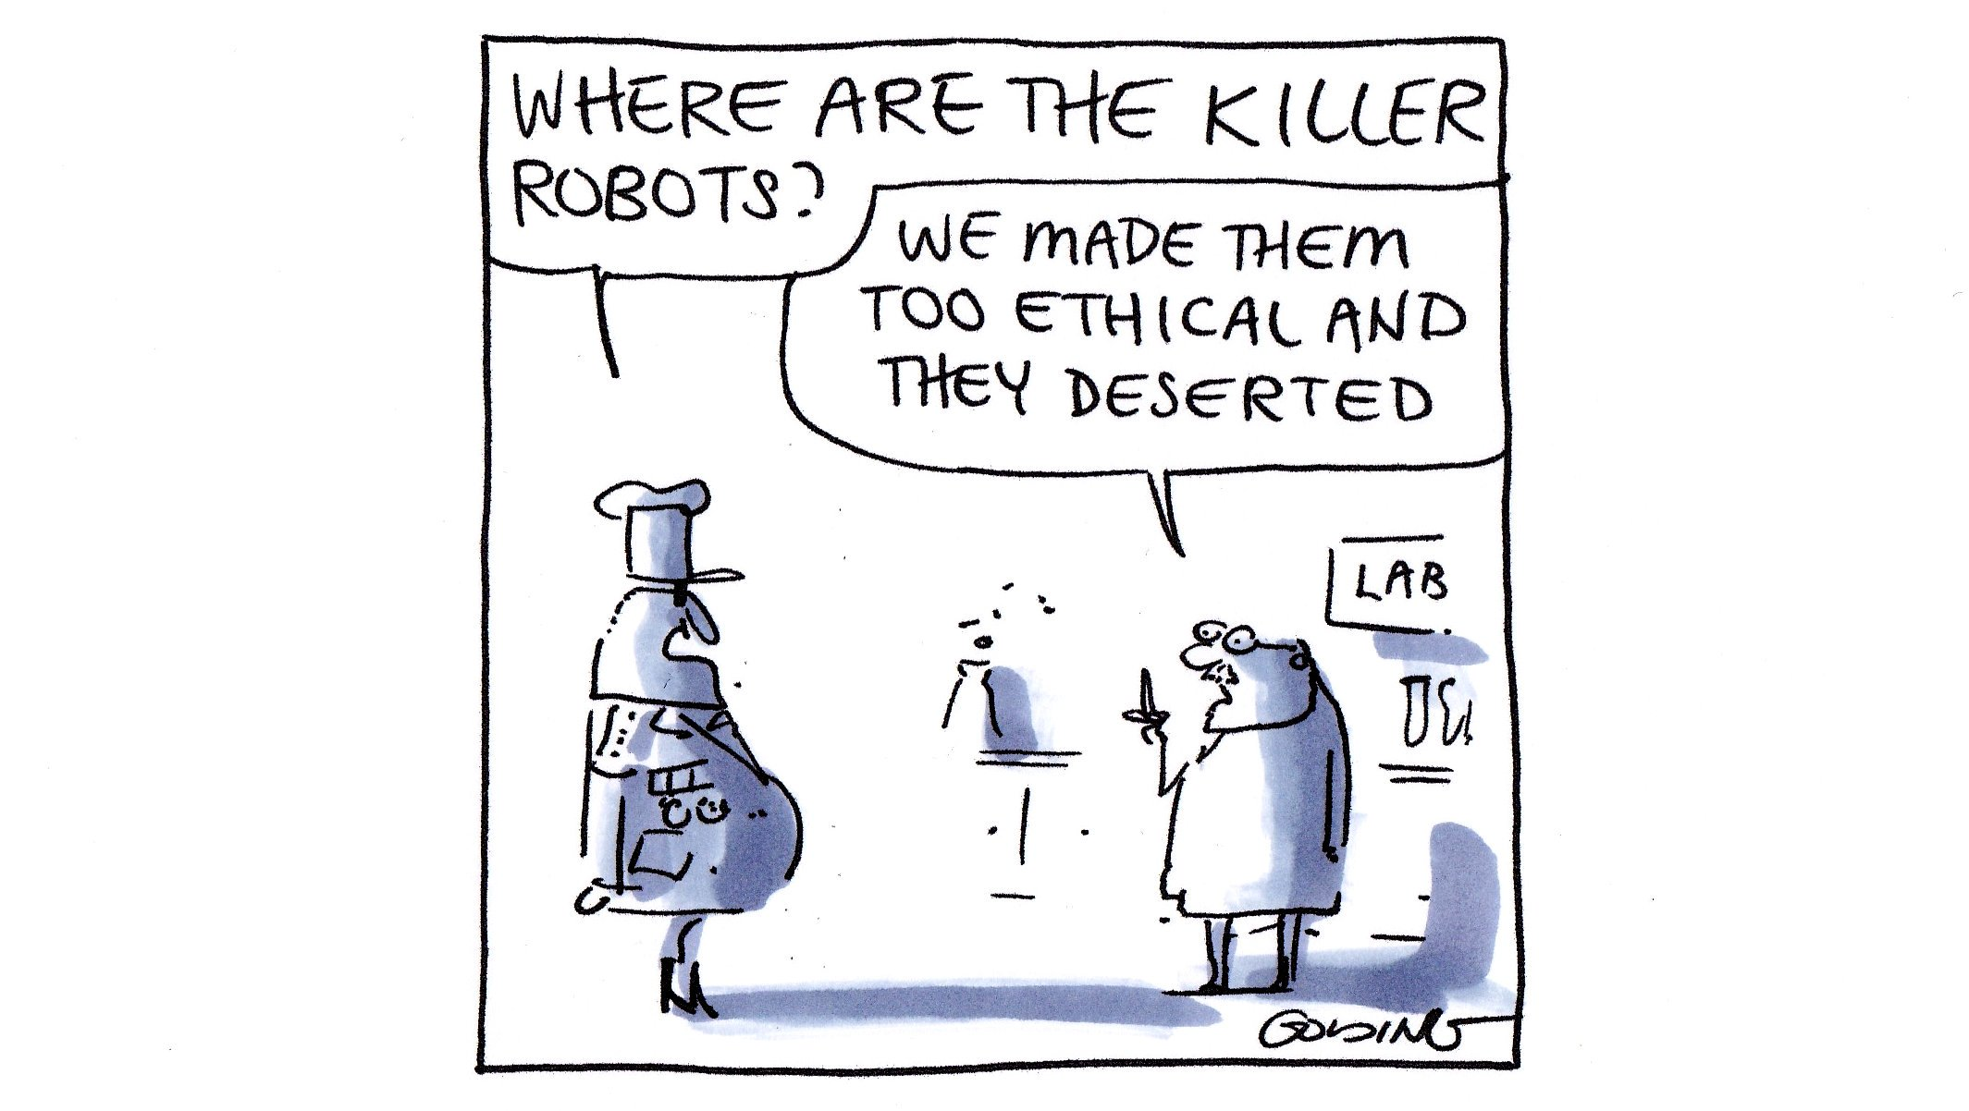
https://twitter.com/GoldingCartoons/status/1101341612121026560/photo/1

Slide 13
Scientific questions (1/2) hESC, hE, civil focus, dual-use …
Human Embryonic Stem Cells (hESC) and Human Embryos (hE)? Are they present? Are they necessary to achieve scientific objectives?
→ Mandatory Ethics Assessment
Exclusive focus on civil applications? Yes / No
→ Decision to fund/reject the action
Dual Use (Regulation 428/2009)
→ Applicants declaration
→ Grant Agreement Preparation

Slide 14
Scientific questions (2/2) Artificial Intelligence, DNSH
Artificial intelligence?
Is it technically robust?
→ Assessed in the excellence criterion
→ Taken into account by ethics evaluators
Do no significant harm (DNSH) principle ('Taxonomy Regulation' 2020/852)
assessed in the excellence criterion
taken into account by ethics evaluators

Slide 15
Application
Ethics Issues Table (1a)
Ethics Self-Assessment (1b-1d)
Shortlisted
PROPOSALS
Ethics Screening of all proposals (2)
Ongoing RESEARCH PROJECTS
Ethics Review* for selected projects (4)
Ethics Assessment of proposals raising complex and/or serious ethics issues (3)
Before Grant agreement!

Slide 16
The HE Application
https://ec.europa.eu/info/funding-tenders/opportunities/docs/2021-2027/horizon/temp-form/af/af_he-ria-ia_en.pdf

Slide 17
Your work ethic matters, your institutions ethic is key

Slide 18
HE Application form Declarations #6
“We declare that the proposal complies with ethical principles (including the highest standards of research integrity as set out in the ALLEA European Code of Conduct for Research Integrity, as well as applicable international and national law, including the Charter of Fundamental Rights of the European Union and the European Convention on Human Rights and its Supplementary Protocols. Appropriate procedures, policies and structures are in place to foster responsible research practices, to prevent questionable research practices and research misconduct, and to handle allegations of breaches of the principles and standards in the Code of Conduct.”

Slide 19
HE Declaration : citation of SOPs
Guideline for Promoting Research Integrity in Research Performing Organizations; The ‘Standard Operating Procedures for Research Integrity’
Research Environment, Supervision and mentoring, Training, Ethics Structures, Data Practices and Management, Collaboration practices, Publication Practices, declarations of Interest, Dealing with breeches

Slide 20
The ethics appraisal process
What to do !

Slide 21
Ethics Panels are (usually) risk averse
The ethics appraisal process
Notes:
… their task is to help the researcher perform the research AND help them learn about ethics AND ,of course, protect the researchers, the research subjects , the environment, the animals used for research purposes……
An incomplete or rushed self-assessment will lead to an ethics review report that will try to cover all bases…

Slide 22
(1a) Ethics Issues Table – proposal application form
To be completed as an essential part of the proposal
If any YES… → Ethics Self-assessment
Section 1: HUMAN EMBRYONIC STEM CELLS AND HUMAN EMBRYOS | YES/no
Does this activity involve Human Embryonic Stem Cells (hESCs).
Does this activity involve the use of living (viable or non-viable) human embryos.
Section 2: HUMANS | YES/no
Does this activity involve human participants.
Notes:
In order to facilitate the researcher in identifying pertinent ethics issue in the project, in part A of the application form the applicant is asked to fill in an EIT with questions focused in the following fields of research.

Slide 23
(1b) Ethics Self-assessment
HE Regulation (art. 19.2): to detail all ethics issues of the proposal, confirm compliance with HE ethical principles/relevant legal framework and describe how it will be ensured
'How to complete your…' guidelines
Section 1: HUMAN EMBRYONIC STEM CELLS AND HUMAN EMBRYOS |  | YES/NO |  | Information to be provided in the proposal | Documents to be provided/kept on file
Does your activity involve Human Embryonic Stem Cells (hESCs)?
If YES: | Will they be directly derived from embryos within this project? |  |  | Research not eligible for funding | Research not eligible for funding
 | Are they previously established cells lines? … |  |  | 1) Origin and line of cells. 2)… | 1) Copies of ethics approval. 2)…
Notes:
For more information on each of the ethics issues and how to address them, including detailed legal references, see the guidelines ‘How to Complete your Ethics Self-Assessment’.

Slide 24
(1c) HE Application Form, EIT table:
Does this activity involve the development, deployment and/or use of Artificial Intelligence? (if yes, detail in the self-assessment whether that could raise ethical concerns related to human rights and values and detail how this will be addressed).

Slide 25
(1d) HE Application Form, Self Assessment
“If you have entered any issues in the ethics issue table, you must perform an ethics self-assessment in accordance with the guidelines "How to Complete your Ethics Self-Assessment" and complete the table below”.
Ethical dimension of the objectives, methodology and likely impact
Explain in detail the identified issues in relation to: – objectives of the activities (e.g. study of vulnerable populations, etc.) – methodology (e.g. clinical trials, involvement of children, protection of personal data, etc.) – the potential impact of the activities (e.g. environmental damage, stigmatisation of particular social groups, political or financial adverse consequences, misuse, etc.)
Compliance with ethical principles and relevant legislations
Describe how the issue(s) identified in the ethics issues table above will be addressed in order to adhere to the ethical principles and what will be done to ensure that the activities are compliant with the E U / national legal and ethical requirements of the country or countries where the tasks are to be carried out.
For activities performed in a non-EU countries, they should also be allowed in at least one EU Member State

Slide 26
(2) Ethics Screening ( 2 ethics experts)
Experts screen all proposals to identify main ethics issues, and flag them for the next steps
No ethics issues ➔ CLEARED
Ethics issues ➔ FLAGGED
Beneficiaries further deal with issues, in accordance with national and European legislation – no further requirements in the Ethics Screening Report
! Experts can require ethics review* or external independent ethics advisor or board
Serious and/or complex ethics issues ➔ ETHICS ASSESSMENT

Slide 27
Ethics screening - Key changes…
Horizon 2020 | Horizon Europe
Pre-screening / Screening | Full Screening for all proposals
→ Formulation of Ethics Requirements = contractual obligations in Grant Agreement | Ethics Issues → Flagged, but no requirements are formulated
…and similarities
Ethics Assessment for proposals raising complex/serious ethics issues (including hE and hESC)
Independent ethics advisor or board can be required
PROJECT Ethics Checks , Reviews and Audits can be initiated by the EC

Slide 28
(3) Ethics Assessment (similar to H2020 – up to 5 Ethics Experts)
An in-depth analysis of the ethics issues for:
All hE or hESC proposals
Proposals raising serious and/or complex ethics issues
For example, when research proposals:
have the potential to violate fundamental rights and freedoms or undermine fundamental EU values
have the potential to result in significant harm to researchers, research participants, the public, animals or the environment
raises multiple or ‘intersectional’ ethics issues (e.g. research into marginalised or vulnerable individual groups that exposes them to the risk of stigmatization, exclusion, reprisals or increased marginalisation)
the area of research is the subject of widespread ethical debate among scientists and ethicists
there are grave doubts regarding the capacity of the researchers or the participating institutions to mitigate effectively the risks
…

Slide 29
(3) Ethics Assessment
Possible Outcomes
ETHICS CLEARANCE → GA is finalized
CONDITIONAL CLEARANCE → Requirements need to be fulfilled, contractual obligations are included in GA
Second ethics assessment → GA is postponed
NO ETHICS CLEARANCE → Proposal cannot be funded

Slide 30
(4) Ethics Review (by 5 Ethics experts)
During the lifetime of the project
When are Ethics Reviews requested?
For projects raising complex or difficult ethics issues;
Compliance with ethics requirements needs to be checked during the implementation;
Decision by the Project officer in the EC/Agency (i.e. documents provided are unsatisfactory)
Full ethics review (5 experts) v ethics check (PO and 1-2 experts if necessary) v ethics audit (on site visit EC and experts)

Slide 31
Ethics Review
Proposal passes
Scientific Evaluation
Ethics
Assessment
Not ethically acceptable ?
Complex / serious ethics issues / hE or hESC ?
Ethics Screening Flagging of Proposals
Proposal rejected
Ethics insufficiently addressed ?
NO ethics issues ?
Ethics
issues ?
Ethics sufficiently
Addressed ?
Conditional clearance
Requirements - Contractual obligations and/or Ethics board/advisor
and/or Ethics review
Ethics advisor/board
and/or Ethics review
can be requested
Ethics clearance
Ethics Review

Slide 32
Ethics and Grant Agreement Preparation (GAP) - Time to grant
From the submission of proposals, the Regulation (Article 28) establishes:
a maximum period of five months to inform all applicants of the outcome of the evaluation
a maximum period of eight months to sign all grant agreements with successful applicants
However…
The periods set forth by the regulation may be exceeded when actions are submitted to an ethics assessment

Slide 33
The responsibility of the applicant
Do not fight your angel….

Slide 35
The ethics appraisal process
Each applicant is responsible for:
identifying any potential ethical issues
handling ethical aspects of their proposal
detailing how they plan to address them in sufficient detail already at the proposal stage.
ASK FOR HELP EARLY, ASK MANY TIMES, but first know what to ask…

Slide 36
What the researchers should do:
The ethics appraisal process
"….We invite you actively to seek advice from colleagues with expertise in the ethics of research: specialised ethics departments, relevant managers in your university/research organisation, hospital research ethics committees, ethics advisors in your company, data protection officers, etc. They will be able to provide you with the necessary information targeted at your specific needs and legal environment."

Slide 37
What the researchers should do:
The ethics appraisal process
"Start thinking (and discussing) about ethics while designing your research protocols. Do not wait until the last minute to seek advice or check what is required under national and European legislation."

Slide 38
What the researchers should do:
The ethics appraisal process
"Consider that ethics issues arise in many areas of research. Apart from the obvious, the medical field, research protocols in social sciences, digital,environmental studies, security research, etc. might involve the voluntary participation of research subjects and the collection of data that might be considered as personal. You must protect your volunteers and also protect yourself (and your colleagues and institutions)."
IN HE misconduct will LEAD TO REDUCTION/RECUPERATION of FUNDS

Slide 39
Time : a rare commodity

Slide 40
HELP is on its way!
1. Ethics help desk: RTD-ETHICS-REVIEW-HELPDESK@ec.europa.eu
2. How to complete your Ethics Self-Assessment
3. Serious and Complex cases guide
4. Data protection guidance
5. Social sciences guidance
6. Artificial Intelligence guidance
7. Horizon Europe Regulation
8. General Model Grant Agreement
9. European Code of Conduct for Research Integrity
10. Charter of Fundamental Rights of the European Union
Notes:
Do not hesitate to seek further advice. The Commission is here to help. Get in touch with us in case you need clarifications or further guidance

Slide 41
Research Ethics and Integrity If you think Ethics is expensive , try misconduct….

Slide 42
THANK YOU
HORIZON EUROPE PORTAL
https://ec.europa.eu/info/funding-tenders/opportunities/portal/screen/how-to-participate/reference-documents;programCode=HORIZON

